Slide 1

PyTorch
About
Chat Bot for Ecommerce
Connect
Sample
Team
Stages
Intro
Educational Chatbot with AI

Slide 2

Connect
Team
About
Sample
Stages
Intro
What is PYTORCH ?
PyTorch is an open source machine learning (ML) framework based on the Python programming language and the Torch library. Torch is an open source ML library used for creating deep neural networks and is written in the Lua scripting language.

Slide 3



CORE
TRAIN
DEVELOP
1
2
3
Connect
Preprocessing
Develop
GUI
About
Sample
Team
Stages
Intro
Preprocessing the Whole data using NLP Techniques
Train the model using Pytorch Neural Networks model
Lets Build the UI for the provided chat bot

Slide 4
Connect
About
Sample
Team
Stages
Intro
Week 1
Week 2
Week 3
Installation , setup and Preprocessing
Training the Model
Developing using GUI

Slide 5

01
03
04
Connect
About
Sample
Team
Stages
Intro
Sanjay & Vinay
Bhavani
Madhu Kiran
Founder & CEO
CIO
Educator
Sanjay and Vinay working as core team in implementation
Bhavani is working on Documentation
Madhu is working in Deployment

Slide 6
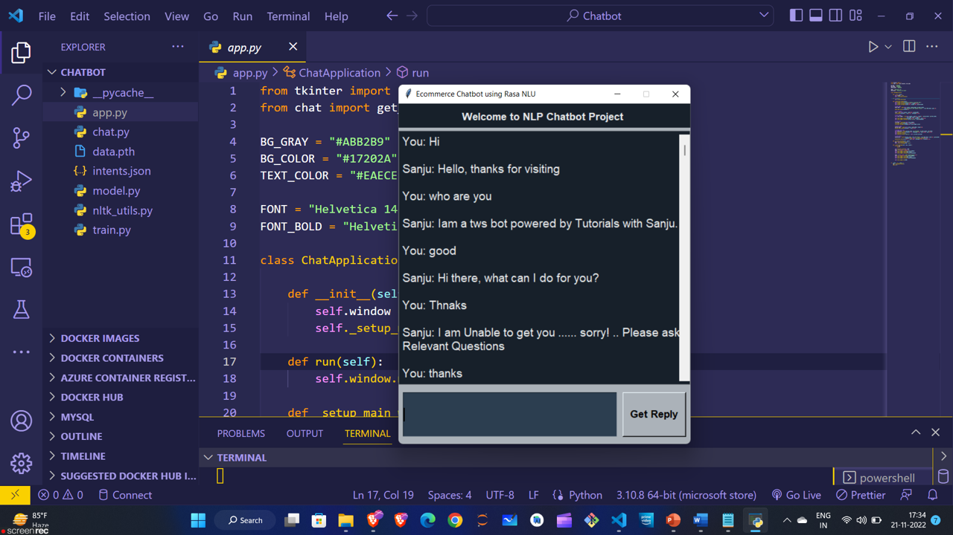
Connect
Sample
About
Team
Stages
Intro

Slide 7



Connect
About
Sample
Team
Stages
Intro
Github
Linkedin
Instagram
Connect with us on Github to get more Projects
Connect with us in Linkedin for more updates
Connect with us on Instagram for more posts

